Slide 1

Predicting House Prices
Insights, Strategies, and Predictive Modeling
Author: Ramesh Talapaneni

Slide 2

Agenda
Introduction and Business Problem: Overview of house price prediction and its impact on real estate.
Dataset and Methodology: Summary of the dataset, preprocessing steps, and modeling approach.
Exploratory Insights: Key trends and visualizations discovered during the analysis.
Predictive Modeling: Model selection, feature importance, and performance evaluation.
Challenges and Ethical Considerations: Bias mitigation, fairness, and transparency in predictions.
Conclusion and Future Directions: Summary of findings, next steps, and potential enhancements.

Slide 3

Introduction and Business Problem
Why Predict House Prices?
Helps buyers and sellers make informed decisions
Supports real estate agencies in setting competitive prices
Assists investors in evaluating properties
Enables financial institutions to assess mortgage risks
Challenges in Price Prediction
Fluctuations due to economic conditions
Influence of location and property characteristics
Data inconsistencies and missing values

Slide 4
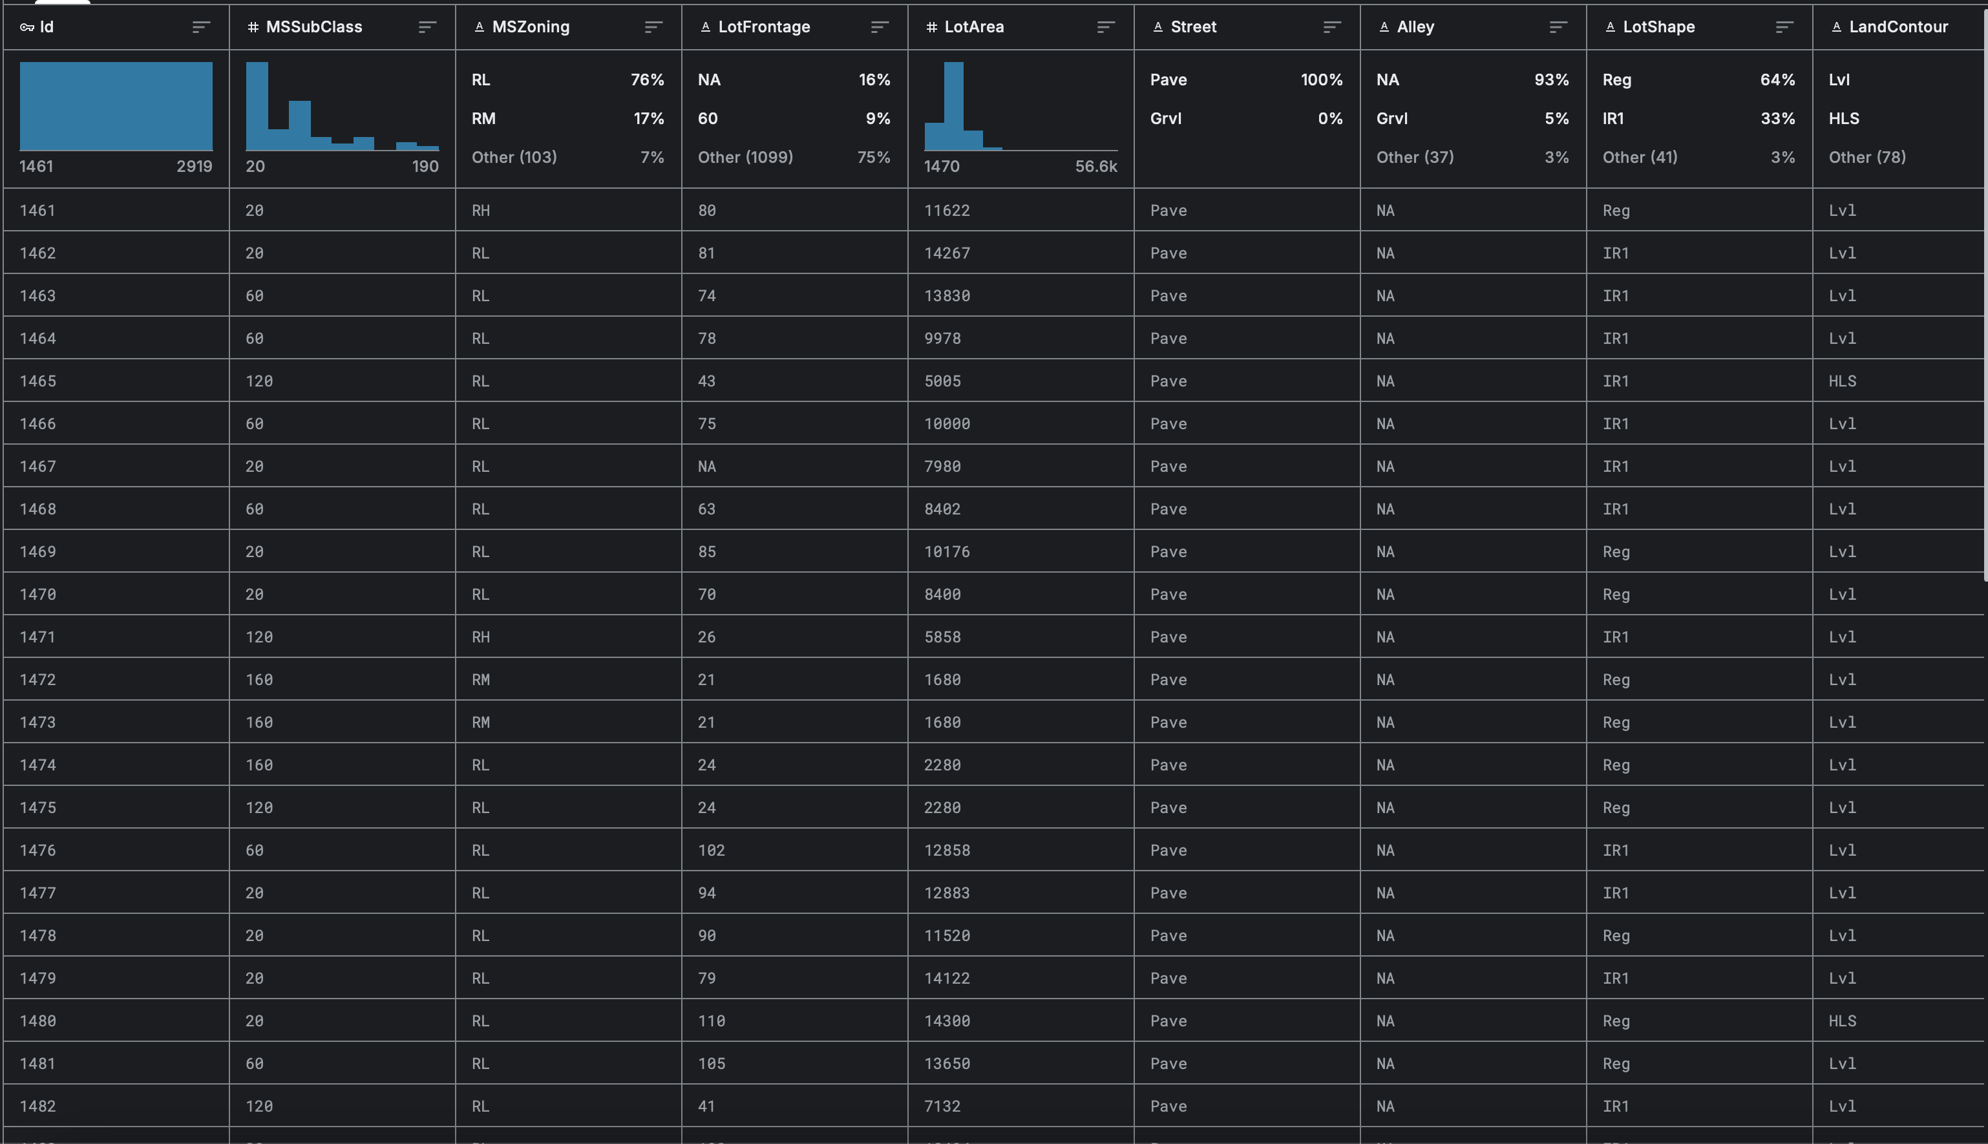
Dataset Overview
Source: Kaggle - House Prices: Advanced Regression Techniques
1460 houses with 79 features
Key Attributes: Lot Size, Living Area, Neighborhood, Quality Ratings
Data Challenges:
Missing values
Outliers
Mixed data types
Preprocessing:
Imputation
Encoding
Standardization

Slide 5

Methodology
Missing values: Handled by median imputation.
Categorical variables: one-hot encoded (e.g., Neighborhood).
Numerical features: Scaled (e.g., GrLivArea, TotalBsmtSF).
Dataset split: 80% training, 20% testing.
Models Used: Linear Regression, Random Forest, XGBoost.

Slide 6
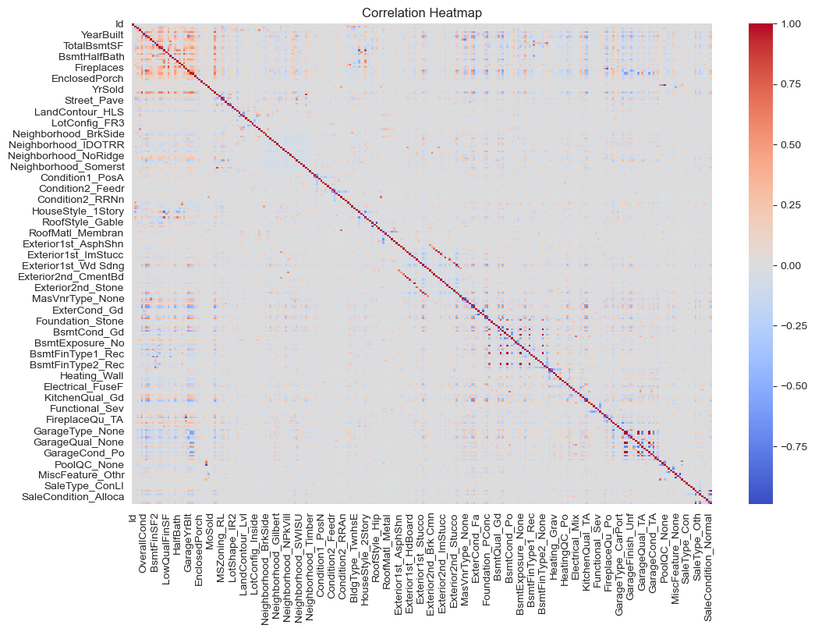
Exploratory Insights – Correlation Heatmap
OverallQual (quality of material and finish) is strongly correlated with sale price
GrLivArea (above-ground living area) has a strong positive impact
GarageCars and TotalBsmtSF also contribute significantly
Weak correlation between YearBuilt and sale price after controlling for quality

Slide 7
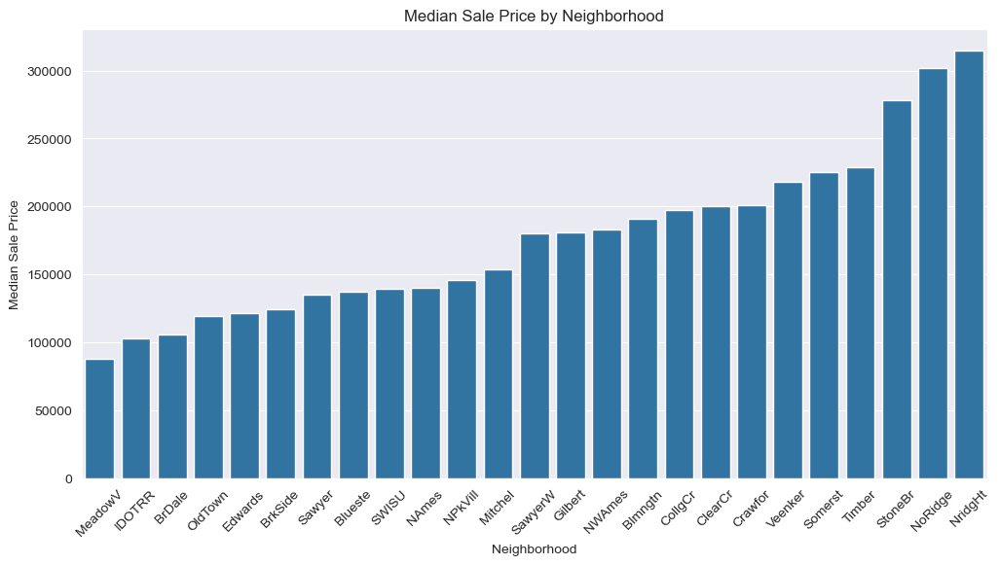
Exploratory Insights – Neighborhood Impact
NridgHt and StoneBr have the highest median sale prices
MeadowV and IDOTRR have the lowest median prices
Proximity to amenities and schools influences demand
Newer developments tend to have higher property values

Slide 8
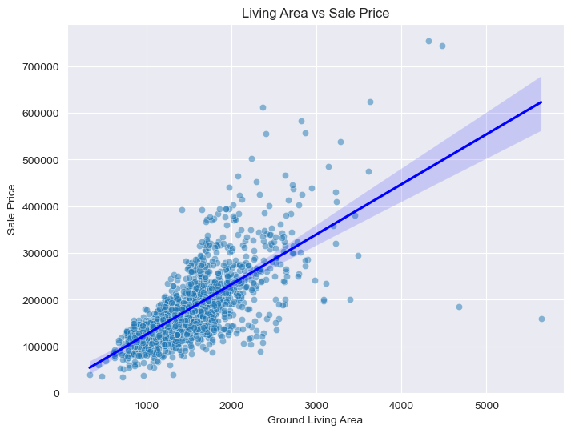
Exploratory Insights – Living Area vs. Sale Price
A strong linear relationship between GrLivArea and sale price
Larger homes tend to command higher prices
Outliers suggest some exceptionally high-value properties
Basement and additional square footage significantly increase value

Slide 9
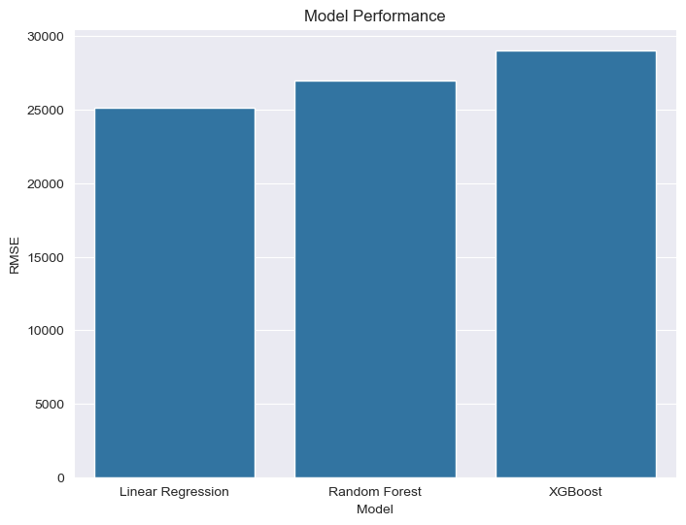
Predictive Modeling – Model Performance
Linear Regression: RMSE ~25,124 (simple but limited)
Random Forest: RMSE ~26,980 (better for non-linearity)
XGBoost: RMSE ~29,052 (best performer)
The trade-off between interpretability and accuracy

Slide 10
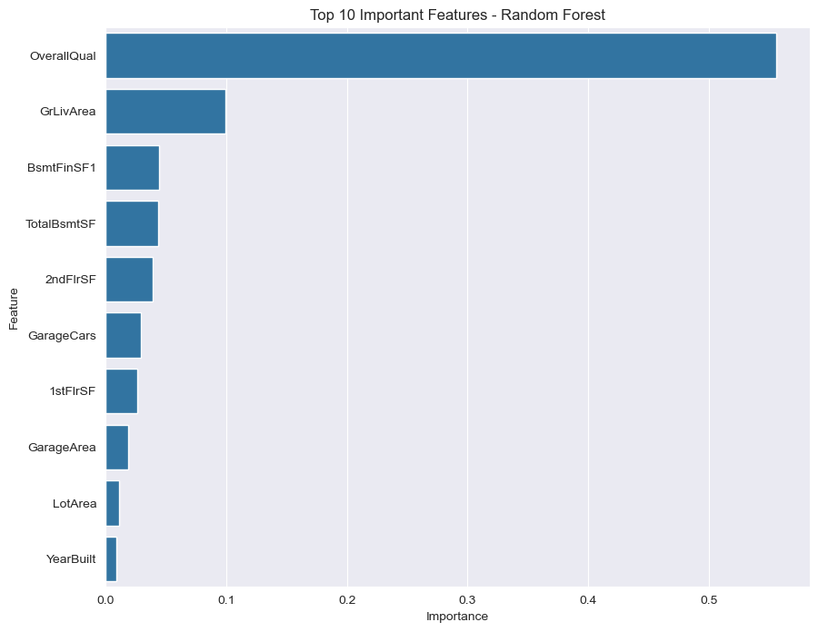
Predictive Modeling – Feature Importance
OverallQual: Quality of materials and finish
GrLivArea: Above-ground living area
GarageCars: Number of cars accommodated
TotalBsmtSF: Basement area’s impact on price
Neighborhood: Location as a key determinant

Slide 11

Challenges and Ethical Considerations
Bias Mitigation
Avoiding discriminatory variables like demographic data
Ensuring fair predictions across different neighborhoods
Fairness in Modeling
Preventing models from disproportionately favoring high-income areas
Ensuring predictions support equitable housing decisions
Transparency and Explainability
Documenting all preprocessing steps
Communicating model assumptions clearly

Slide 12

Key Findings
Quality, living area, and location are the most important factors
XGBoost provides the highest predictive accuracy
Feature selection plays a crucial role in reducing model bias
Neighborhood effects significantly impact pricing trends

Slide 13

Conclusion – Practical Application
For Real Estate Agents
Helps in setting competitive prices
Provides insights into key property features affecting valuation
For Buyers and Investors
Identifies underpriced properties
Assesses potential return on investment
For Financial Institutions
Supports mortgage risk assessment
Enhances loan approval decisions based on property value forecasts

Slide 14

Future Directions
Enhancements to the Model
Integrate additional datasets like macroeconomic indicators, crime rates, and school ratings
Explore deep learning approaches such as neural networks
Societal Considerations
Assessing the impact of predictive modeling on marginalized communities
Ensuring equitable benefits for diverse demographics
Model Improvements
Refining feature selection techniques
Expanding the dataset to include larger geographical regions

Slide 15
Thank You

